Slide 1
AVR Microcontroller
Microprocessor Course
Third Chapter
BRANCH, CALL, AND TIME DELAY LOOP
Aban 1393

Slide 2
BRANCH, CALL, AND TIME DELAY LOOP 3.1 BRANCH INSTRUCTIONS AND LOOPING
Loop is Repeating a sequence of instructions or an operation a certain number of times. The loop is one of most widely used programming techniques.
In the AVR, there are several ways to repeat an operation many times. One way is to repeat the operation over and over until it is finished, as shown below:
LDI R16,0 ;R16 = 0
LDI R17,3 ;R17 = 3
ADD R16,R17 ;add value 3 to R16 (R16 = 0x03)
ADD R16,R17 ;add value 3 to R16 (R16 = 0x06)
ADD R16,R17 ;add value 3 to R16 (R16 = 0x09)
ADD R16,R17 ;add value 3 to R16 (R16 = OxOC)
ADD R16,R17 ;add value 3 to R16 (R16 = OxOF)
ADD R16,Rl7 ;add value 3 to R16 (R16 = 0x12)
One problem with the above program is that too much code space would be needed to increase the number of repetitions to 50 or 100.

Slide 3
BRANCH, CALL, AND TIME DELAY LOOP 3.1 BRANCH INSTRUCTIONS AND LOOPING
Using BRNE instruction for looping
A much better way is to use a loop. The BRNE (branch if not equal) instruction uses the zero flag in the status register. The BRNE instruction is used as follows:
BACK: ......... ;start of the loop
......... ;body of the loop
......... ;body of the loop
DEC Rn ;decrement Rn, Z = 1 if Rn = 0
BRNE BACK ;branch to BACK if Z = 0
Notes:
In the last two instructions, the Rn (e.g., R16 or R17) is decremented; if it is not zero, it branches (jumps) back to the target address referred to by the label. Prior to the start of the loop, the Rn is loaded with the counter value for the number of repetitions. Notice that the BRNE instruction refers to the Z flag of the status register affected by the previous instruction, DEC. This is shown in Example 3-1.

Slide 4
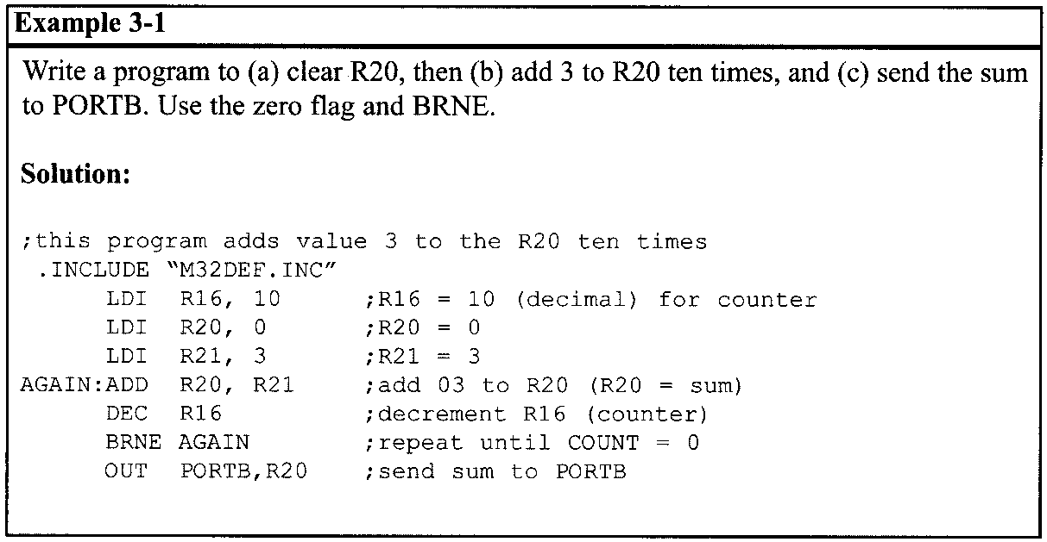
BRANCH, CALL, AND TIME DELAY LOOP 3.1 BRANCH INSTRUCTIONS AND LOOPING
Using BRNE instruction for looping
Notes:
In the program in Example 3-1, register R16 is used as a counter. The counter is first set to 10. In each iteration, the DEC instruction decrements the R16 and sets the flag bits accordingly. If R16 is not zero (Z = 0), it jumps to the target address associated with the label "AGAIN". This looping action continues until R16 becomes zero. After R16 becomes zero (Z = I), it falls through the loop and executes the instruction immediately below it, in this case "OUT PORTB, R20". See Figure 3-1.

Slide 5
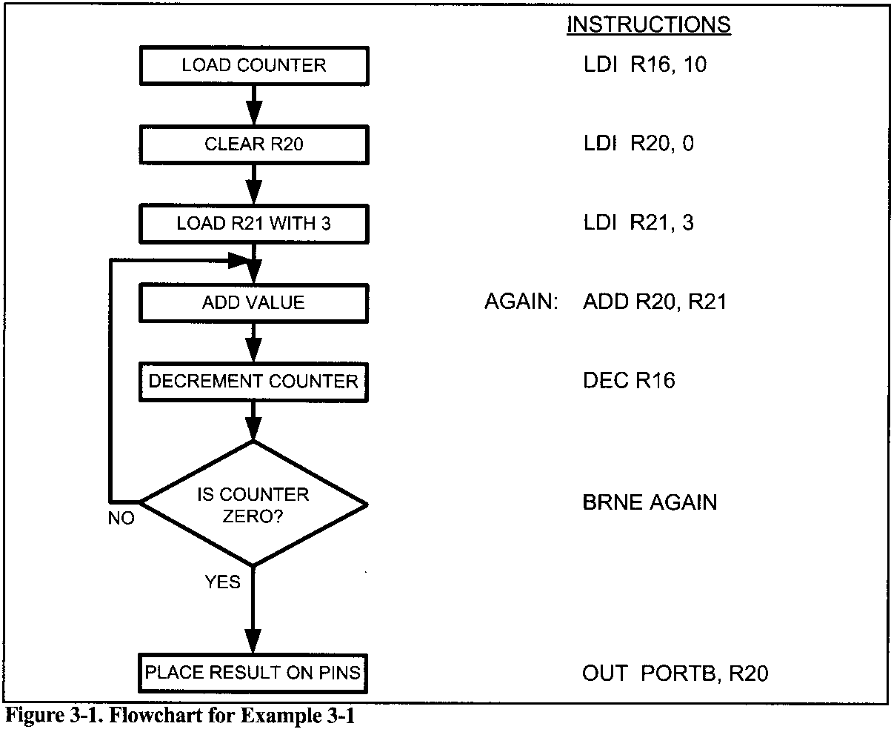
BRANCH, CALL, AND TIME DELAY LOOP 3.1 BRANCH INSTRUCTIONS AND LOOPING
Using BRNE instruction for looping

Slide 6
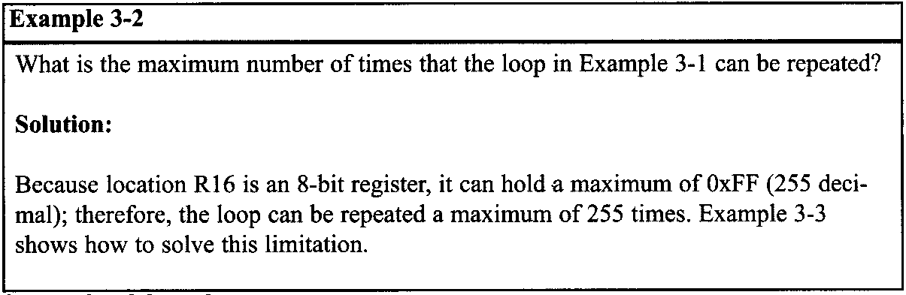
BRANCH, CALL, AND TIME DELAY LOOP 3.1 BRANCH INSTRUCTIONS AND LOOPING

Slide 7
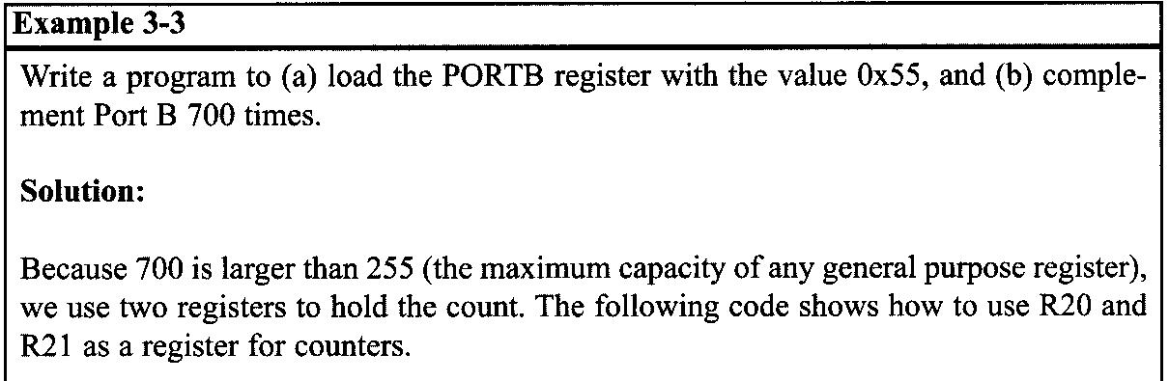
BRANCH, CALL, AND TIME DELAY LOOP 3.1 BRANCH INSTRUCTIONS AND LOOPING
Loop inside a loop
What happens if we want to repeat an action more times than 255? To do that, we use a loop inside a loop, which is called a nested loop. In a nested loop, we use two registers to hold the count.

Slide 8
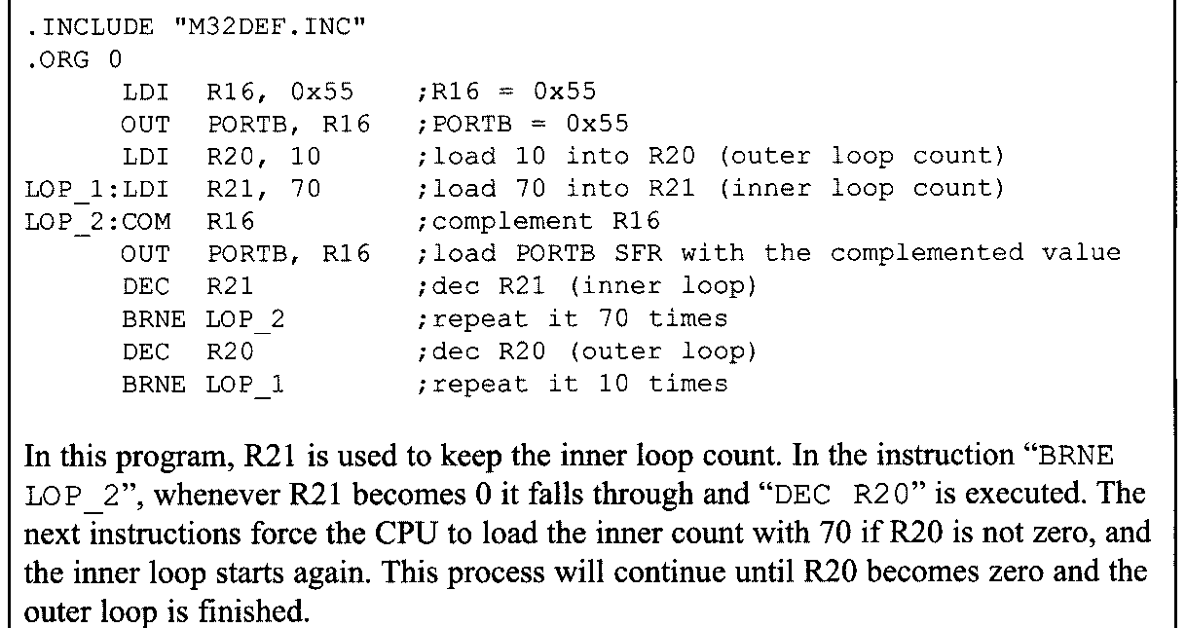
BRANCH, CALL, AND TIME DELAY LOOP 3.1 BRANCH INSTRUCTIONS AND LOOPING
Loop inside a loop

Slide 9
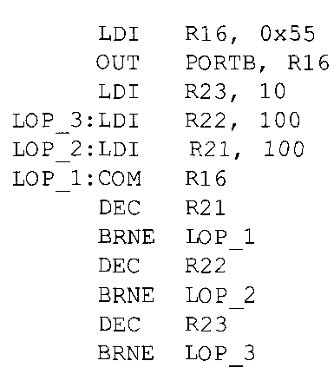
BRANCH, CALL, AND TIME DELAY LOOP 3.1 BRANCH INSTRUCTIONS AND LOOPING
Looping 100,000 times
Because two registers give us a maximum value of 65,025, we can use three registers to get up to more than 16 million (2²⁴ iterations. The following code repeats an action 100,000 times:

Slide 10
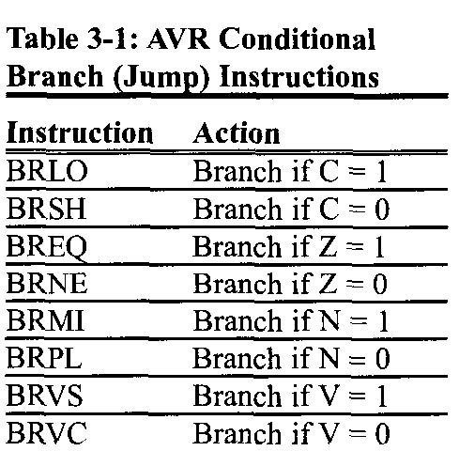
BRANCH, CALL, AND TIME DELAY LOOP 3.1 BRANCH INSTRUCTIONS AND LOOPING
Other conditional jumps
In Table 3-1 you see some of the conditional branches for the AVR. In Table 3-1 notice that the instructions, such as BREQ (Branch if Z = 1) and BRLO (Branch if C = I), jump only if a certain condition is met. Next, we examine some conditional branch instructions with examples.

Slide 11
BRANCH, CALL, AND TIME DELAY LOOP 3.1 BRANCH INSTRUCTIONS AND LOOPING
BREQ (branch if equal, branch if Z = 1)
In this instruction, the Z flag is checked. If it is high, the CPU jumps to the target address. For example, look at the following code.
OVER: IN R20,PINB ;read PINB and put it in R20
TST R20 ;set the flags according to R20
BREQ OVER ;jump if R20 is zero
In this program, if PINB is zero, the CPU jumps to the label OVER. It stays in the loop until PINB has a value other than zero.
Notes:
Notice that the TST instruction can be used to examine a register and set the flags according to the contents of the register without performing an arithmetic instruction such as decrement.
When the TST instruction executes, if the register contains the zero value, the zero flag is set; otherwise, it is cleared.

Slide 12
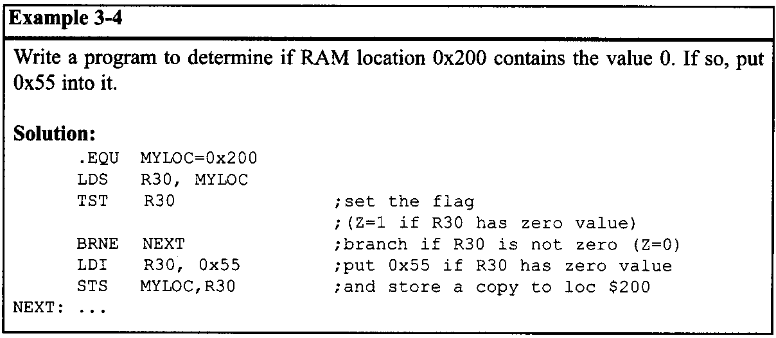
BRANCH, CALL, AND TIME DELAY LOOP 3.1 BRANCH INSTRUCTIONS AND LOOPING
BRSH (branch if same or higher, branch if C = 0)
In executing "BRSH", the processor looks at the carry flag to see if it is raised (C = 1). If it is not, the CPU starts to fetch and execute instructions from the address of the label. If C = 1, it will not branch but will execute the next instruction below BRSH.

Slide 13
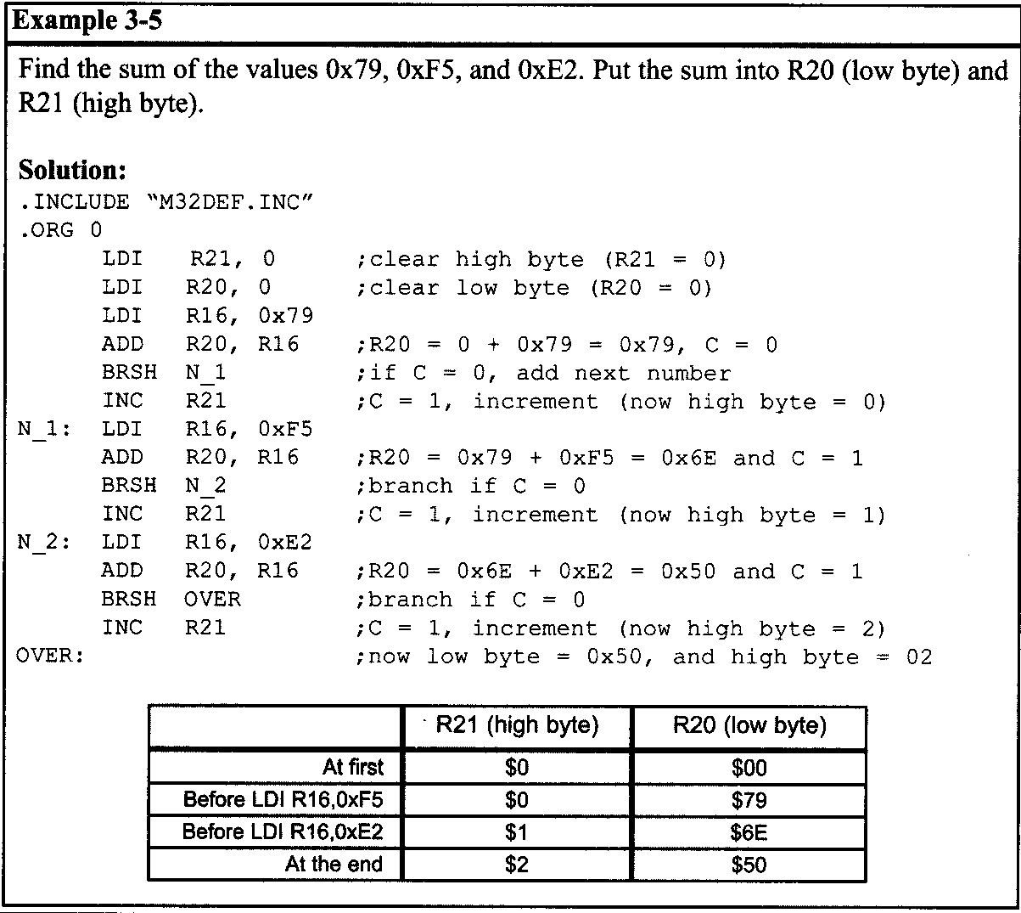
BRANCH, CALL, AND TIME DELAY LOOP 3.1 BRANCH INSTRUCTIONS AND LOOPING

Slide 14
BRANCH, CALL, AND TIME DELAY LOOP 3.1 BRANCH INSTRUCTIONS AND LOOPING
The other conditional branch instructions in Table 3-1 are discussed in Chapter 5 when arithmetic operations with signed numbers are discussed.
All conditional branches are short jumps
It must be noted that all conditional jumps are short jumps, meaning that the address of the target must be within 64 bytes of the program counter (PC). This concept is discussed next.

Slide 15
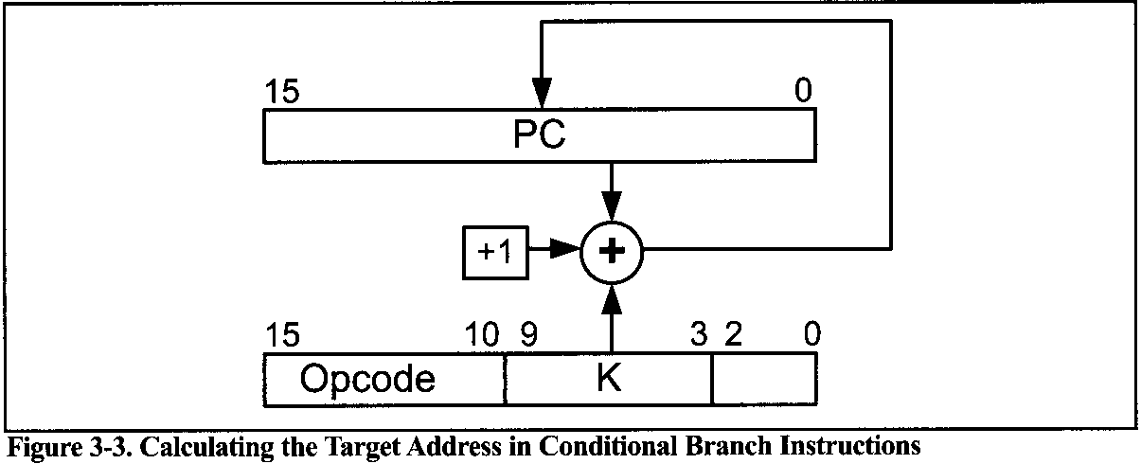
BRANCH, CALL, AND TIME DELAY LOOP 3.1 BRANCH INSTRUCTIONS AND LOOPING
Calculating the short branch address
All conditional branches such as BRSH, BREQ, and BRNE are short branches due to the fact that they are all 2-byte instructions. In these instructions the opcode is 9 bits and the relative address is 7 bits.
The target address is relative to the value of the program counter.
If the relative address is positive, the jump is forward.
If the relative address is negative, then the jump is backwards.
The relative address can be a value from -64 to +63.
Notes:
To calculate the target address, the relative address is added to the PC of the next instruction (target address = relative address + PC). See Example 3-6. We do the same thing for the backward branch, although the second byte is negative. That is, we add it to the PC value of the next instruction. See Example 3-7.

Slide 16
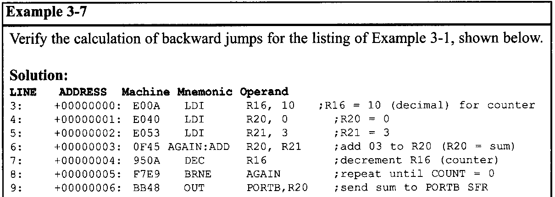
BRANCH, CALL, AND TIME DELAY LOOP 3.1 BRANCH INSTRUCTIONS AND LOOPING
In the program list, "BRNE AGAIN" has machine code F7E9. Because the binary equivalent of the instruction is 1111 0111 1110 1001,the opcode is 111101001 and the operand (relative address) is 1111101. The 1111101 gives us -3, which means the displacement is -3.
When the relative address of -3 is added to 000006, the address of the instruction below, we have -3 + 06 = 03 (the carry is dropped). Notice that 000003 is the address of the label AGAIN. 1111101 is a negative number, which means it will branch backward.

Slide 17
BRANCH, CALL, AND TIME DELAY LOOP 3.1 BRANCH INSTRUCTIONS AND LOOPING
Unconditional branch instruction
The unconditional branch is a jump in which control is transferred unconditionally to the target location. In the AVR there are three unconditional branches:
JMP (jump),
RJMP (relative jump), and
IJMP (indirect jump).
Deciding which one to use depends on the target address.

Slide 18
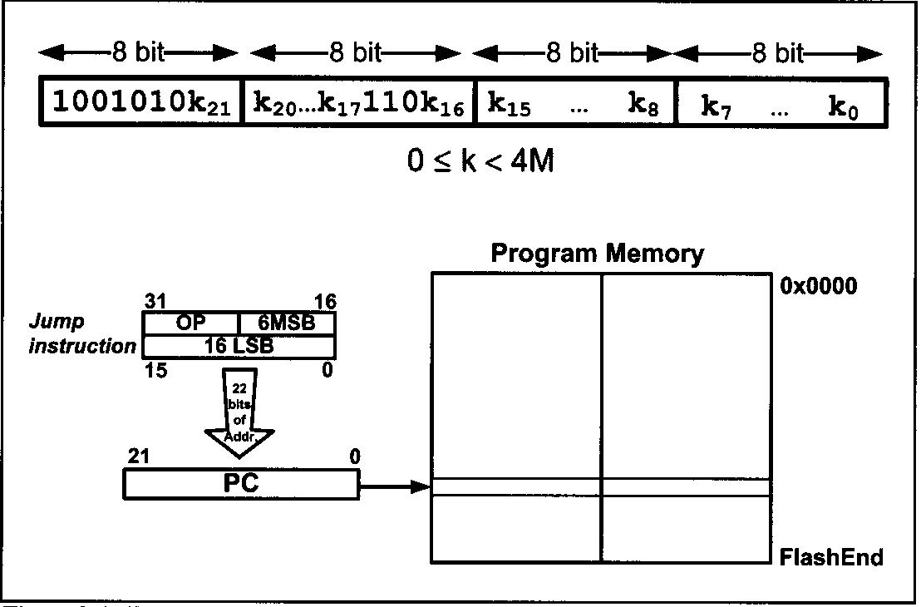
BRANCH, CALL, AND TIME DELAY LOOP 3.1 BRANCH INSTRUCTIONS AND LOOPING
JMP (JMP is a long jump)
JMP is an unconditional jump that can go to any memory location in the 4M (word) address space of the AVR.
Notes:
It is a 4-byte (32-bit) instruction in which 10 bits are used for the opcode, and the other 22 bits represent the 22-bit address of the target location. The 22-bit target address allows a jump to 4M (words) of memory locations from 000000 to $3FFFFF..

Slide 19
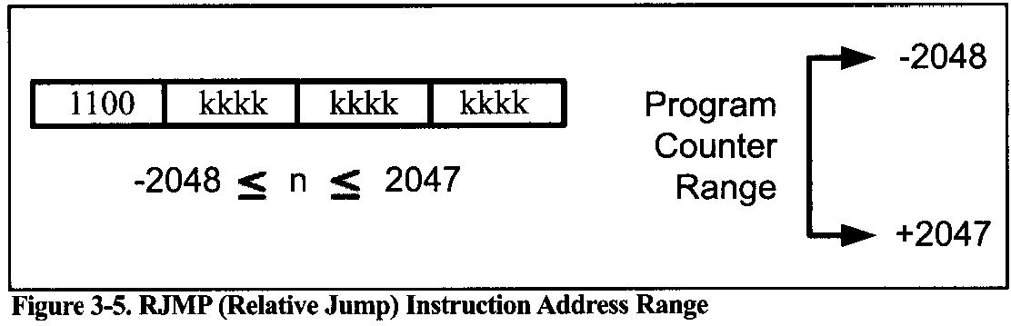
BRANCH, CALL, AND TIME DELAY LOOP 3.1 BRANCH INSTRUCTIONS AND LOOPING
RJMP (relative jump)
In this 2-byte (16-bit) instruction, the first 4 bits are the opcode and the rest (lower 12 bits) is the relative address of the target location.
Notes:
The relative address range of 000 - $FFF is divided into forward and backward jumps; that is, within -2048 to +2047 words of memory relative to the address of the current PC (program counter). If the jump is forward, then the relative address is positive. If the jump is backward, then the relative address is negative. In this regard, RJMP is like the conditional branch instructions except that 12 bits are used for the offset address instead of 7. This is shown in detail in Figure 3-5.

Slide 20
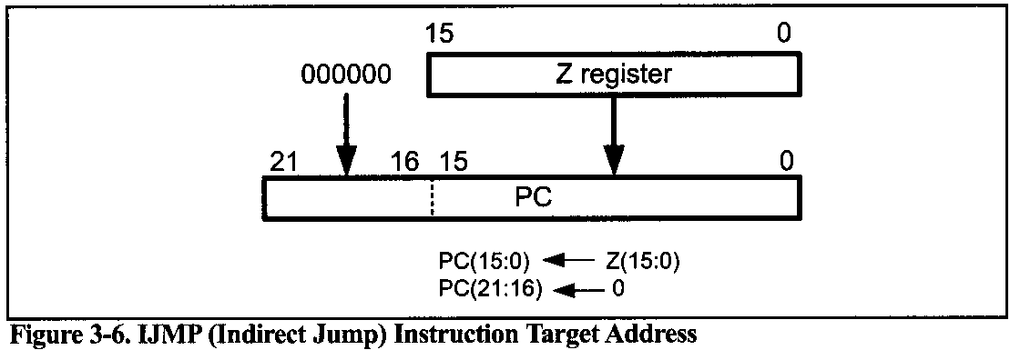
BRANCH, CALL, AND TIME DELAY LOOP 3.1 BRANCH INSTRUCTIONS AND LOOPING
IJMP (indirect jump)
IMP is a 2-byte instruction. When the instruction executes, the PC is loaded with the contents of the Z register, so it jumps to the address pointed to by the Z register.
Notes:
Z is a 2-byte register, so IJMP can jump within the lowest 64K words of the program memory.
In the other jump instructions, the target address is static, which means that in a specific condition they jump to a fixed point. But IJMP has a dynamic target point, and we can dynamically change the target address by changing the Z register's contents through the program.

Slide 21
BRANCH, CALL, AND TIME DELAY LOOP 3.2: CALL INSTRUCTIONS AND STACK
CALL INSTRUCTIONS
Another control transfer instruction is the CALL instruction, which is used to call a subroutine. Subroutines are often used to perform tasks that need to be performed frequently. This makes a program more structured in addition to saving memory space. In the AVR there are four instructions for the call subroutine:
CALL (long call)
RCALL (relative call),
ICALL (indirect 4 to Z), and
EICALL (extended indirect call to Z).
The choice of which one to use depends on the target address.
Notes:
Z is a 2-byte register, so IJMP can jump within the lowest 64K words of the program memory.
In the other jump instructions, the target address is static, which means that in a specific condition they jump to a fixed point. But IJMP has a dynamic target point, and we can dynamically change the target address by changing the Z register's contents through the program.

Slide 22
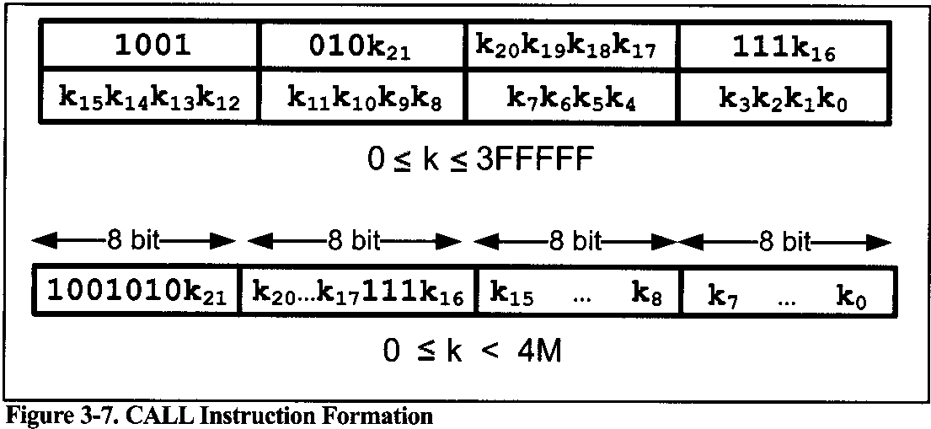
BRANCH, CALL, AND TIME DELAY LOOP 3.2: CALL INSTRUCTIONS AND STACK
CALL
In this 4-byte (32-bit) instruction, 10 bits are used for the opcode and the other 22 bits, k21-k0, are used for the address of the target subroutine, just as in the JMP instruction.
Notes:
Therefore, CALL can be used to call subroutines located anywhere within the 4M address space of 000000-$3FFFFF for the AVR, as shown in Figure 3-7.
To make sure that the AVR knows where to come back to after execution of the called subroutine, the microcontroller automatically saves on the stack the address of the instruction immediately below the CALL.
When a subroutine is called, control is transferred to that subroutine, and the processor saves the PC (program counter) of the next instruction on the stack and begins to fetch instructions from the new location.
After finishing execution of the subroutine, the RET instruction transfers control back to the caller. Every subroutine needs RET as the last instruction.

Slide 23
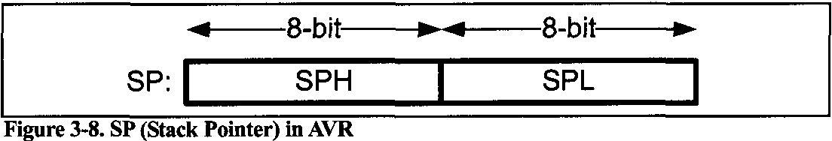
BRANCH, CALL, AND TIME DELAY LOOP 3.2: CALL INSTRUCTIONS AND STACK
How stacks are accessed in the AVR
The stack is a section of RAM, there must be a register inside the CPU to point to it. The register used to access the stack is called the SP (stack pointer) register.
In I/O memory space, there are two registers named SPL (the low byte of the SP) and SPH (the high byte of the SP). The SP is implemented as two registers.
The stack pointer in the AVRs with more than 256 bytes of memory the SP is made of two 8-bit registers (SPL and SPH), while in the AVRs with less than 256 bytes the SP is made of only SPL, as an 8-bit register can address 256 bytes of memory.

Slide 24
BRANCH, CALL, AND TIME DELAY LOOP 3.2: CALL INSTRUCTIONS AND STACK
Pushing onto the stack
As we push data onto the stack, the data are saved where the SP points to, and the SP is decremented by one.
To push a register onto stack we use the PUSH instruction.
PUSH Rr ;Rr can be any of the general purpose registers (R0-R31)
For example, to store the value of R10 we can write the following instruction:
PUSH R10 ;store R10 onto the stack, and decrement SP

Slide 25
BRANCH, CALL, AND TIME DELAY LOOP 3.2: CALL INSTRUCTIONS AND STACK
Popping from the stack
When the POP instruction is executed, the SP is incremented and the top location of the stack is copied back to the register. That means the stack is LIFO (Last-In-First-Out) memory.
To retrieve a byte of data from stack we can use the POP instruction
POP Rr ;Rr can be any of the general purpose registers (RObR31)
For example, the following instruction pops from the top of stack and copies to R10:
POP R16 ;inrement SP, and then load top of Stack to R16

Slide 26
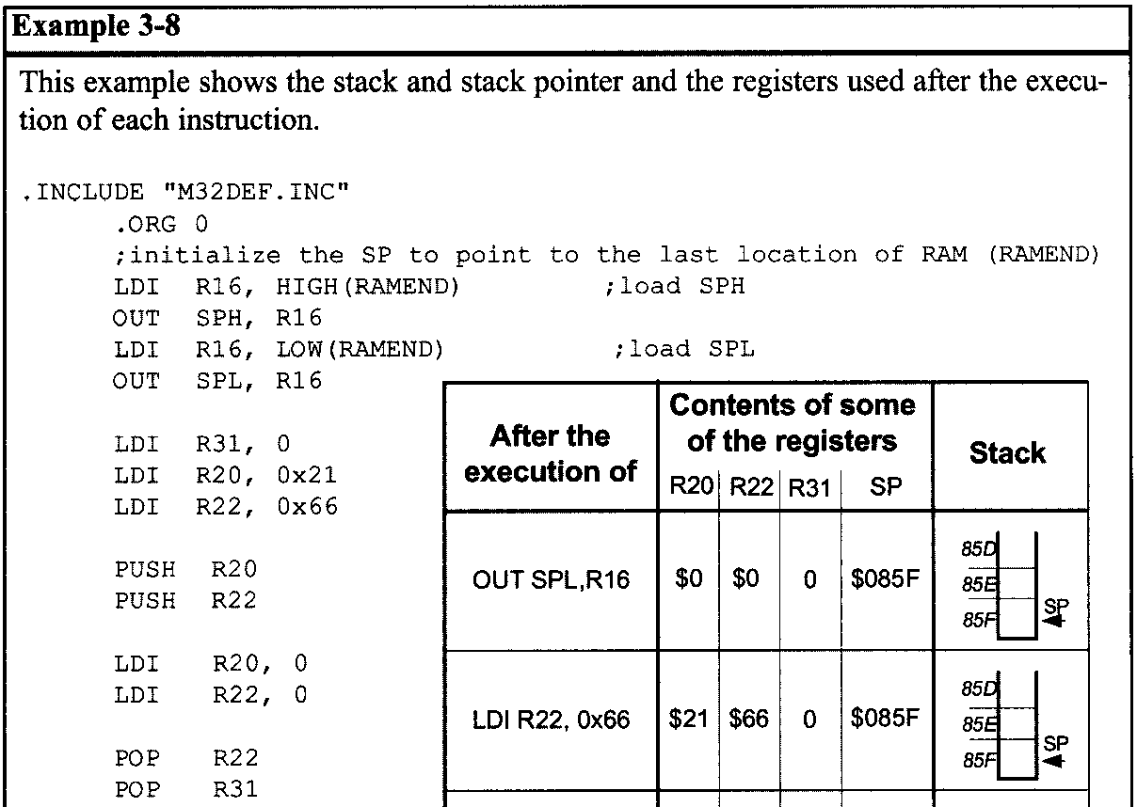
BRANCH, CALL, AND TIME DELAY LOOP 3.2: CALL INSTRUCTIONS AND STACK

Slide 27
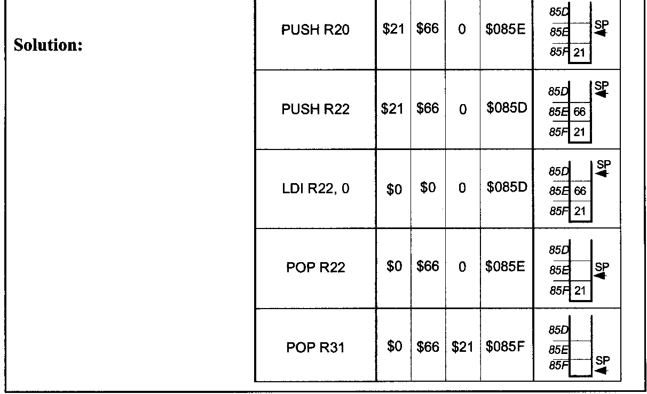
BRANCH, CALL, AND TIME DELAY LOOP 3.2: CALL INSTRUCTIONS AND STACK

Slide 28
BRANCH, CALL, AND TIME DELAY LOOP 3.2: CALL INSTRUCTIONS AND STACK
Initializing the stack pointer
When the AVR is powered up, the SP register contains the value 0. Therefore, we must initialize the SP at the beginning of the program so that it points to somewhere in the internal SRAM. So, it is common to initialize the SP to the uppermost memory location.
Different AVRs have different amounts of RAM. In the AVR assembler RAMEND represents the address of the last RAM location. So, if we want to initialize the SP so that it points to the last memory location, we can simply load RAMEND into the SP.
LDI R16, HIGH(RAMEND) ;load SPH
OUT SPH, R16
LDI R16, LOW(RAMEND) ;load SPL
OUT SPL, R16

Slide 29
BRANCH, CALL, AND TIME DELAY LOOP 3.2: CALL INSTRUCTIONS AND STACK
CALL instruction and the role of the stack
When a subroutine is called,
the processor first saves the address of the instruction just below the CALL instruction on the stack,
And then transfers control to that subroutine.
For the AVRs whose program counter is not longer than 16 bits (e.g., ATmegal28, ATmega32), the value of the program counter is broken into 2 bytes. The higher byte is pushed onto the stack first, and then the lower byte is pushed.
For the AVRs whose program counters are longer than 16 bits but shorter than 24 bits, the value of the program counter is broken up into 3 bytes. The highest byte is pushed first, then the middle byte is pushed, and finally the lowest byte is pushed.

Slide 30
BRANCH, CALL, AND TIME DELAY LOOP 3.2: CALL INSTRUCTIONS AND STACK
RET instruction and the role of the stack
When the RET instruction at the end of the subroutine is executed, the top location of the stack is copied back to the program counter and the stack pointer is incremented. so when the execution of the function finishes and RET is executed, the address of the instruction below the CALL is loaded into the PC, and the instruction below the CALL instruction is executed.

Slide 31
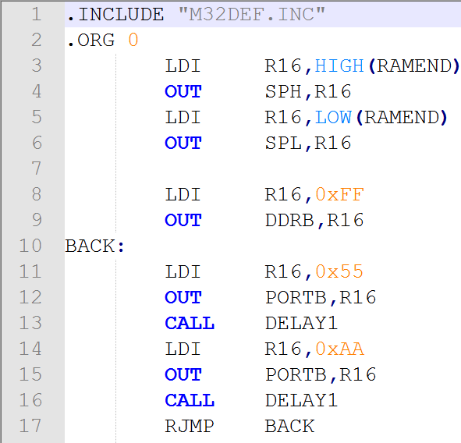
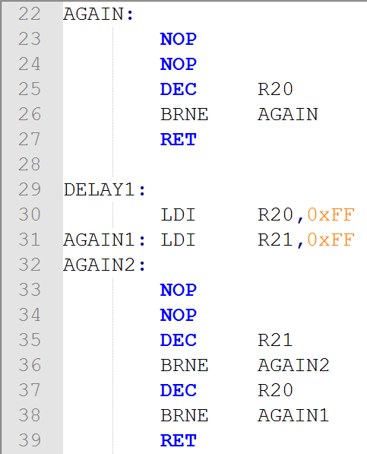
BRANCH, CALL, AND TIME DELAY LOOP 3.2: CALL INSTRUCTIONS AND STACK
Example 3-9
Toggle all bits of Port B by sending to it the value 0x55 and 0xAA continuously. Put a time delay between each issuing of data to Port B.
Notes:
The following points should be noted for the program in Example 3-9:
1- Notice the DELAY subroutine. After the first "CALL DELAY" is executed, the address of the instruction right below it, "LDI R16, OXAA", is pushed onto the stack. and the AVR starts to execute instructions at address 0x300.
2- In the DELAY subroutine, the counter R20 is set to 255 (R20 = OxFF); therefore, the loop is repeated 255 times. When R20 becomes 0, control falls to the RET instruction, which pops the address from the top of the stack into the program counter and resumes executing the instructions after the CALL.

Slide 32
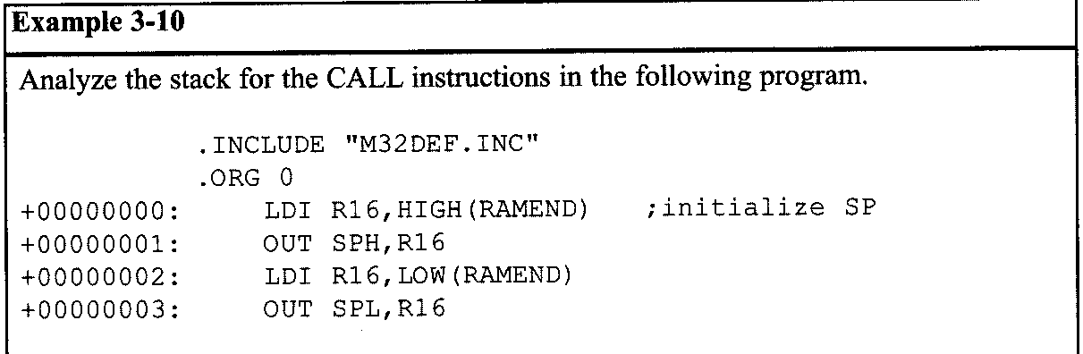
BRANCH, CALL, AND TIME DELAY LOOP 3.2: CALL INSTRUCTIONS AND STACK
The upper limit of the stack
As mentioned earlier, we can define the stack anywhere in the general purpose memory. So, in the AVR the stack can be as big as its RAM. Note that we must not define the stack in the register memory, nor in the I/O memory. So, the SP must be set to point above 0x60. In AVR, the stack is used for calls and interrupts.

Slide 33
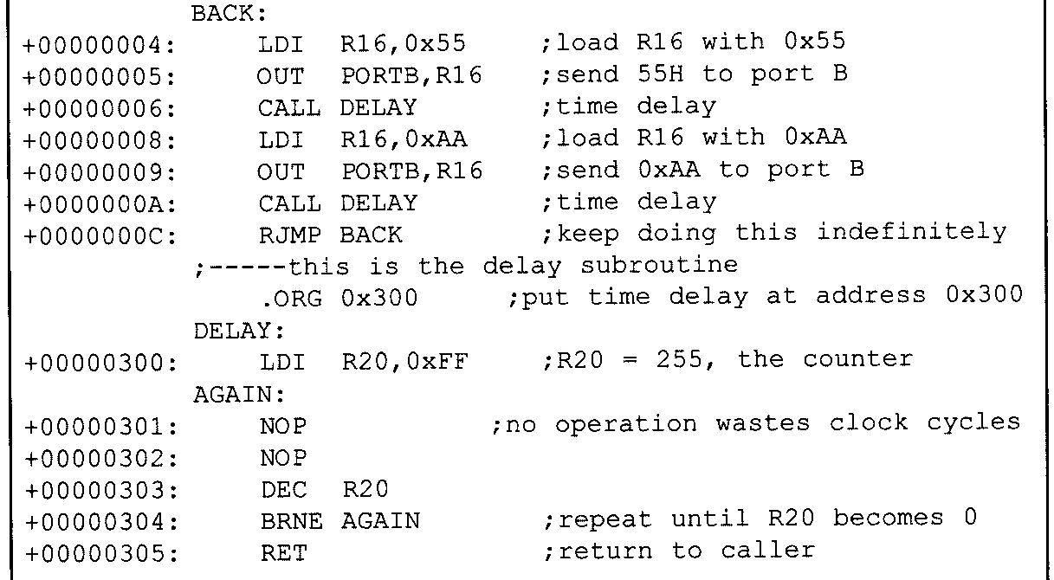
BRANCH, CALL, AND TIME DELAY LOOP 3.2: CALL INSTRUCTIONS AND STACK

Slide 34
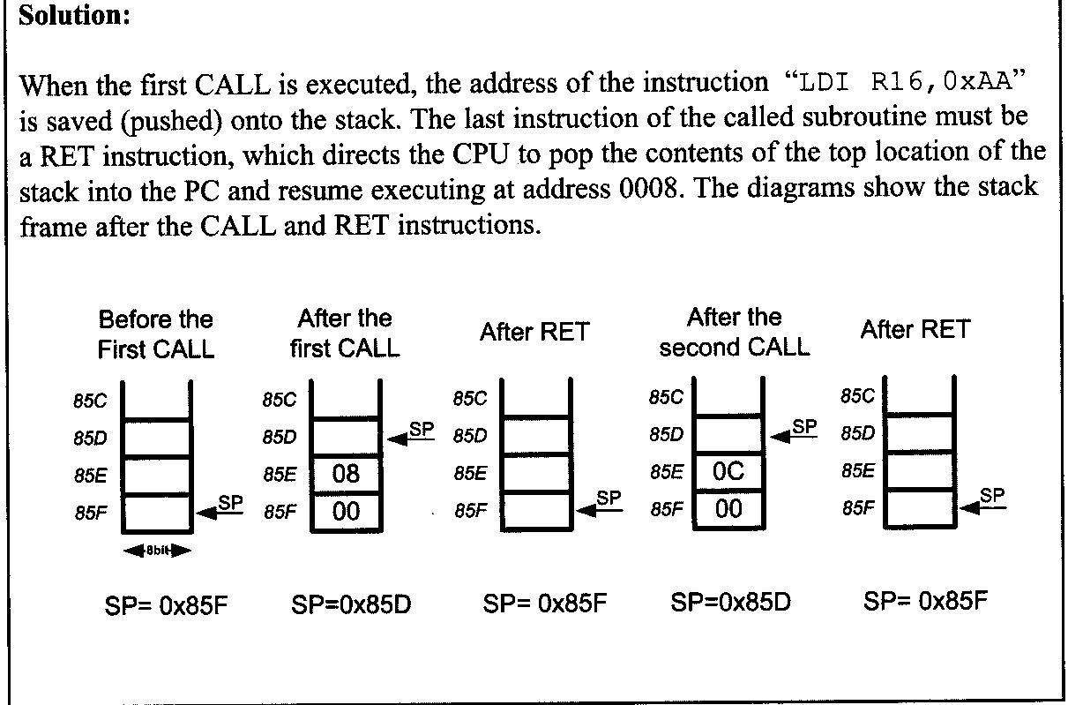
BRANCH, CALL, AND TIME DELAY LOOP 3.2: CALL INSTRUCTIONS AND STACK

Slide 35
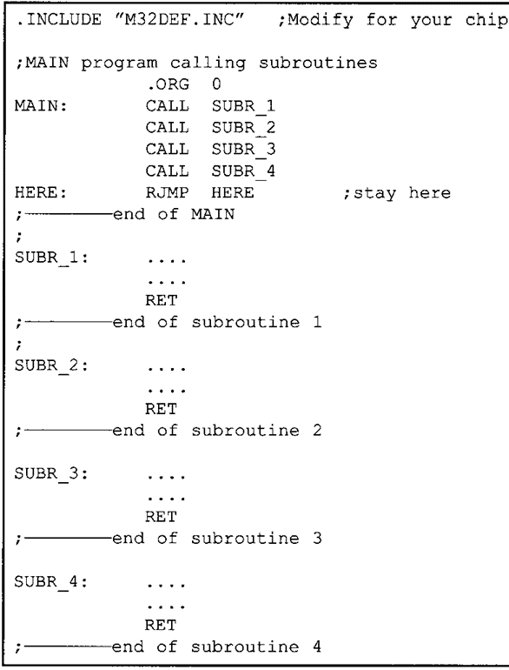
BRANCH, CALL, AND TIME DELAY LOOP 3.2: CALL INSTRUCTIONS AND STACK
Calling many subroutines from the main program
In Assembly language programming, it is common to have one main program and many subroutines that are called from the main program. It needs to be emphasized that in using CALL, the target address of the subroutine can be anywhere within the 4M (word) memory space of the AVR.

Slide 36

BRANCH, CALL, AND TIME DELAY LOOP 3.2: CALL INSTRUCTIONS AND STACK
RCALL (relative call)
RCALL is a 2-byte instruction in contrast to CALL, which is 4 bytes.
Write a program to count up from 00 to 0xFF and send the count to Port B. Use one call subroutine for sending the data to Port B. and another one for time delay.Put a time delay between each issuing of data to Port B.
Notes:
Because RCALL is a 2-byte instruction, and only 12 bits of the 2 bytes are used for the address, the target address of the subroutine must be within -2048 to +2047 words of memory relative to the address of the current PC.

Slide 37
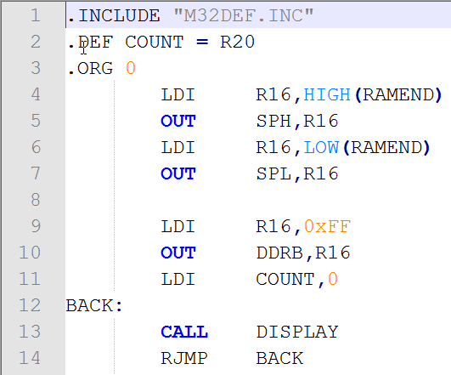
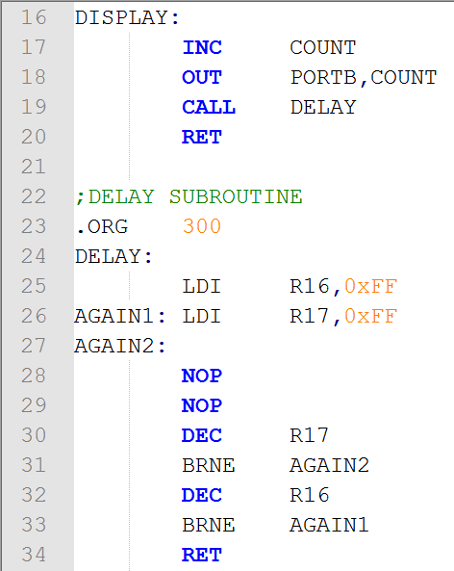
BRANCH, CALL, AND TIME DELAY LOOP 3.2: CALL INSTRUCTIONS AND STACK
Notes:
There is no difference between RCALL and CALL in terms of saving the program counter on the stack or the function of the RET instruction. The only difference is that the target address for CALL can be anywhere within the 4M address space of the AVR while the target address of RCALL must be within a 4K range.

Slide 38
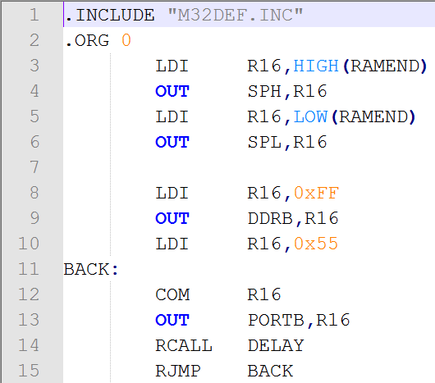
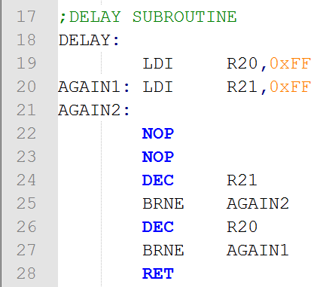
BRANCH, CALL, AND TIME DELAY LOOP 3.2: CALL INSTRUCTIONS AND STACK
Rewrite the main part of Example 3-9 as efficiently as you can.
Notes:
Of course, in addition to using compact instructions, we can program efficiently by having a detailed knowledge of all the instructions supported by a given microcontroller, and using them wisely. Look at Examples 3-12 and 3-13.

Slide 39
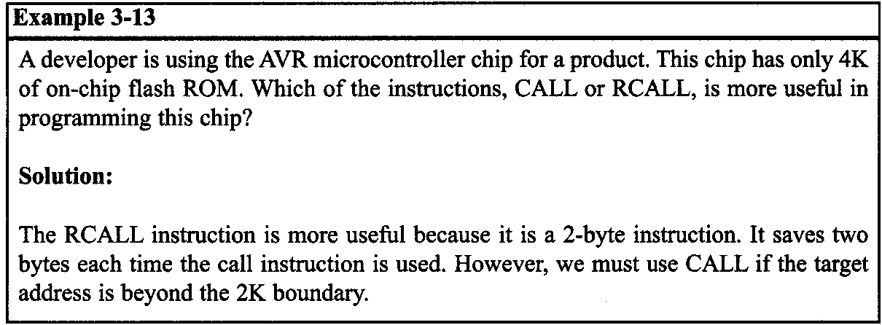
BRANCH, CALL, AND TIME DELAY LOOP 3.2: CALL INSTRUCTIONS AND STACK
Notes:
Of course, in addition to using compact instructions, we can program efficiently by having a detailed knowledge of all the instructions supported by a given microcontroller, and using them wisely. Look at Examples 3-12 and 3-13.

Slide 40
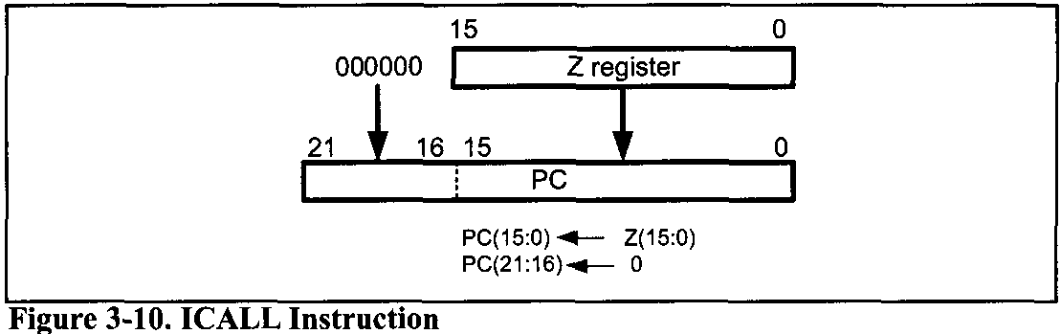
BRANCH, CALL, AND TIME DELAY LOOP 3.2: CALL INSTRUCTIONS AND STACK
ICALL (indirect call)
In this 2-byte (16-bit) instruction, the Z register specifies the target address.
Notes:
When the instruction is executed, the address of the next instruction is pushed into the stack (like CALL and RCALL) and the program counter is loaded with the contents of the Z register. So, the Z register should contain the address of a function when the ICALL instruction is executed. Because the Z register is 16 bits wide, the ICALL instruction can call the subroutines that are within the lowest 64K words of the program memory. See Figure 3-10.

Slide 41
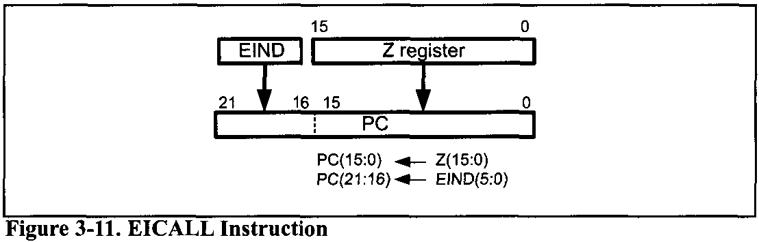
BRANCH, CALL, AND TIME DELAY LOOP 3.2: CALL INSTRUCTIONS AND STACK
ICALL (indirect call)
In the AVRs with more than 64K words of program memory, the EICALL (extended indirect call) instruction is available. The EICALL loads the Z register into the lower 16 bits of the PC and the EIND register into the upper 6 bits of the PC. Notice that EIND is a part of I/O memory.
Notes:
The ICALL and EICALL instructions can be used to implement pointer to function.

Slide 42
BRANCH, CALL, AND TIME DELAY LOOP 3.3: AVR TIME DELAY AND INSTRUCTION PIPELINE
Delay calculation for the AVR
In creating a time delay using Assembly language instructions, one must be mindful of two factors that can affect the accuracy of the delay:
The crystal frequency: The frequency of the crystal oscillator connected to the XTALl and XTAL2 input pins is one factor in the time delay calculation.
The AVR design: Advances in both IC technology and CPU design in the 1980s and 1990s have made the single instruction cycle a common feature of many microcontrollers. One might wonder how microprocessors such as AVR are able to execute an instruction in one cycle. There are three ways to do that:
(a) Use Harvard architecture to get the maximum amount of code and data into the CPU,
(b) use RISC architecture features such as fixed-size instructions, and finally
(c) use pipelining to overlap fetching and execution of instructions.
Notes:
Indeed, one way to increase performance without losing code compatibility with the older generation of a given family is to reduce the number of instruction cycles it takes to execute an instruction.

Slide 43
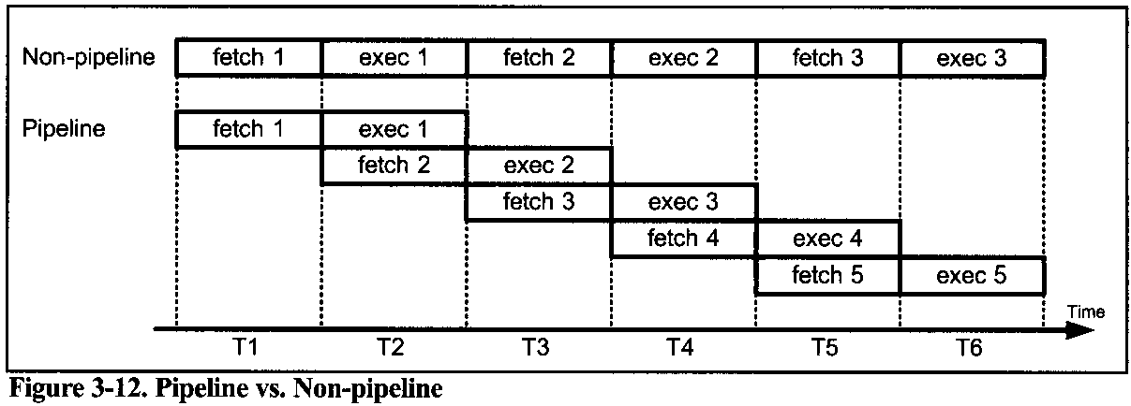
BRANCH, CALL, AND TIME DELAY LOOP 3.3: AVR TIME DELAY AND INSTRUCTION PIPELINE
Pipelining
In early microprocessors such as the 8085, the CPU could either fetch or execute at a given time. In other words, the CPU had to fetch an instruction from memory, then execute it; and then fetch the next instruction, execute it, and so on. The idea of pipelining in its simplest form is to allow the CPU to fetch and execute at the same time.

Slide 44
BRANCH, CALL, AND TIME DELAY LOOP 3.3: AVR TIME DELAY AND INSTRUCTION PIPELINE
Pipelining
We can use a pipeline to speed up execution of instructions. In pipelining, the process of executing instructions is split into small steps that are all executed in parallel. In this way, the execution of many instructions is overlapped. One limitation of pipelining is that the speed of execution is limited to the slowest stage of the pipeline.

Slide 45
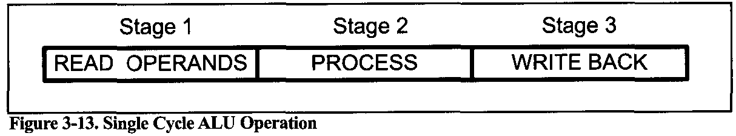
BRANCH, CALL, AND TIME DELAY LOOP 3.3: AVR TIME DELAY AND INSTRUCTION PIPELINE
AVR multistage execution pipeline
As shown in Figure 3-13, in the AVR, each instruction is executed in 3 stages: operand fetch, ALU operation execution, and result write back.
In step 1, the operand is fetched. In step 2, the operation is performed; for example, the adding of the two numbers is done. In step 3, the result is written into the destination register.

Slide 46
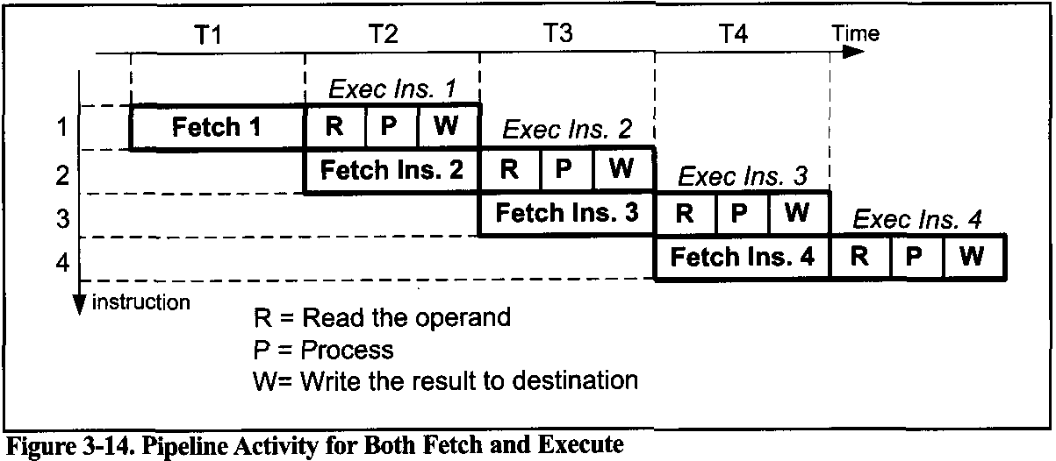
BRANCH, CALL, AND TIME DELAY LOOP 3.3: AVR TIME DELAY AND INSTRUCTION PIPELINE
AVR multistage execution pipeline
In reality, one can construct the AVR pipeline for three instructions.

Slide 47
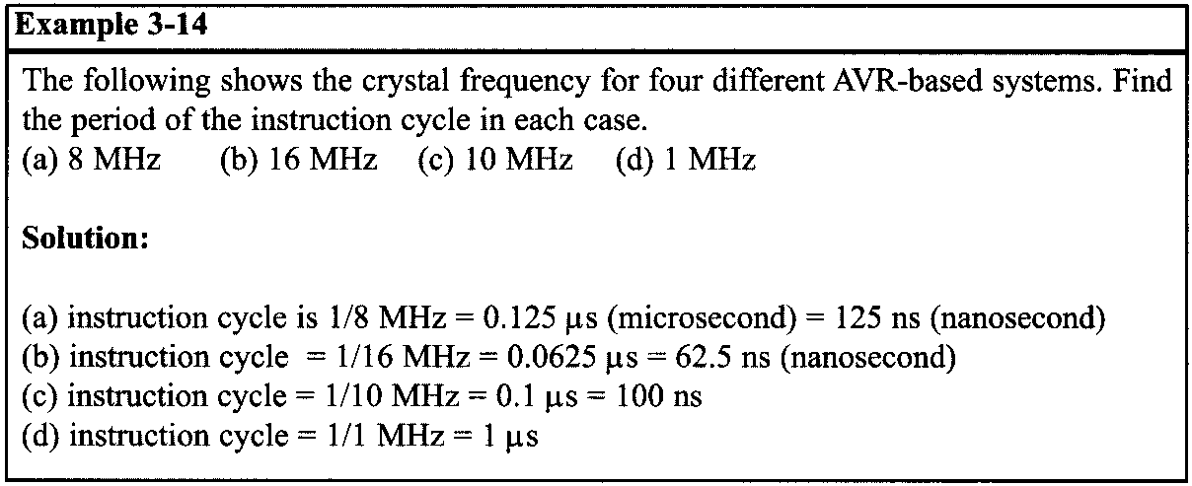
BRANCH, CALL, AND TIME DELAY LOOP 3.3: AVR TIME DELAY AND INSTRUCTION PIPELINE
Instruction cycle time for the AVR
It takes a certain amount of time for the CPU to execute an instruction. This time is referred to as machine cycles. Most instructions take no more than one or two machine cycles to execute.
In the AVR, one machine cycle consists of one oscillator period, which means that with each oscillator clock, one machine cycle passes. Therefore, to calculate the machine cycle for the AVR, we take the inverse of the crystal frequency, as shown in Example 3-14.

Slide 48
BRANCH, CALL, AND TIME DELAY LOOP 3.3: AVR TIME DELAY AND INSTRUCTION PIPELINE
Branch penalty
For the concept of pipelining to work, we need a buffer or queue in which an instruction is prefetched and ready to be executed. In some circumstances, the CPU must flush out the queue. For example, when a branch instruction is executed, the CPU starts to fetch codes from the new memory location, and the code in the queue that was fetched previously is discarded. In this case, the execution unit must wait until the fetch unit fetches the new instruction. This is called a branch penalty.
The penalty is an extra instruction cycle.
This means that while the vast majority of AVR instructions take only one machine cycle, some instructions take two, three, or four machine cycles. These are JMP, CALL, RET, and all the conditional branch instructions such as BRNE, BRLO, and so on.

Slide 49
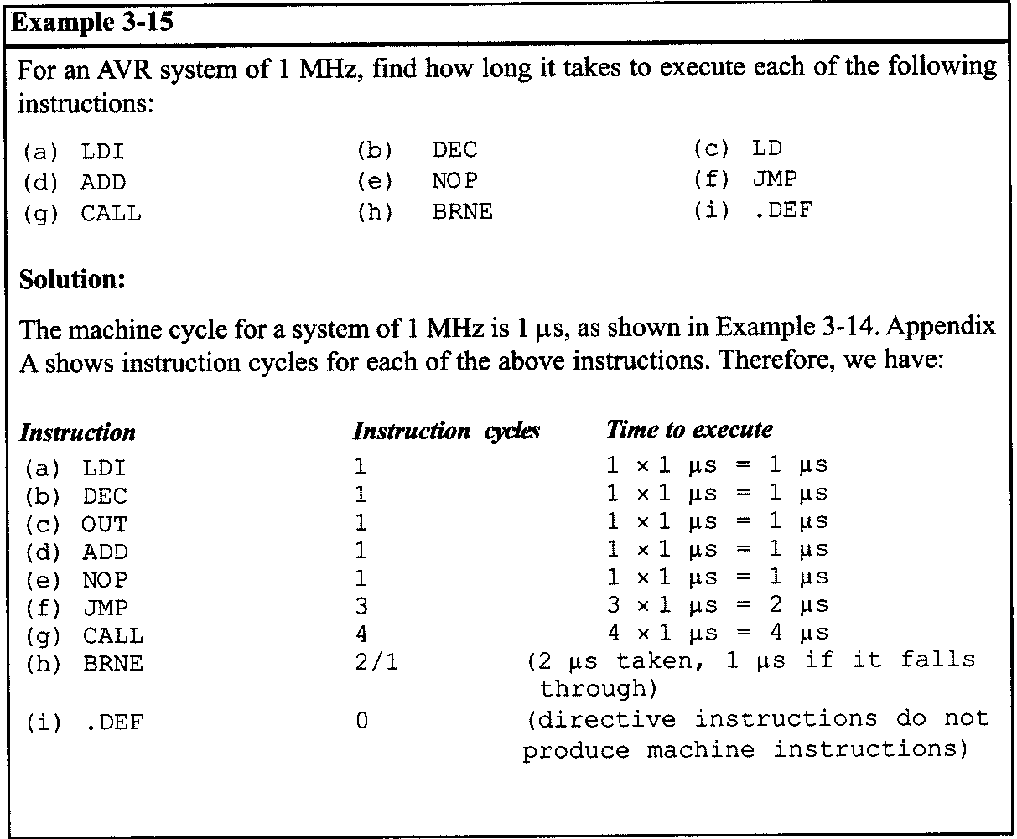
BRANCH, CALL, AND TIME DELAY LOOP 3.3: AVR TIME DELAY AND INSTRUCTION PIPELINE

Slide 50
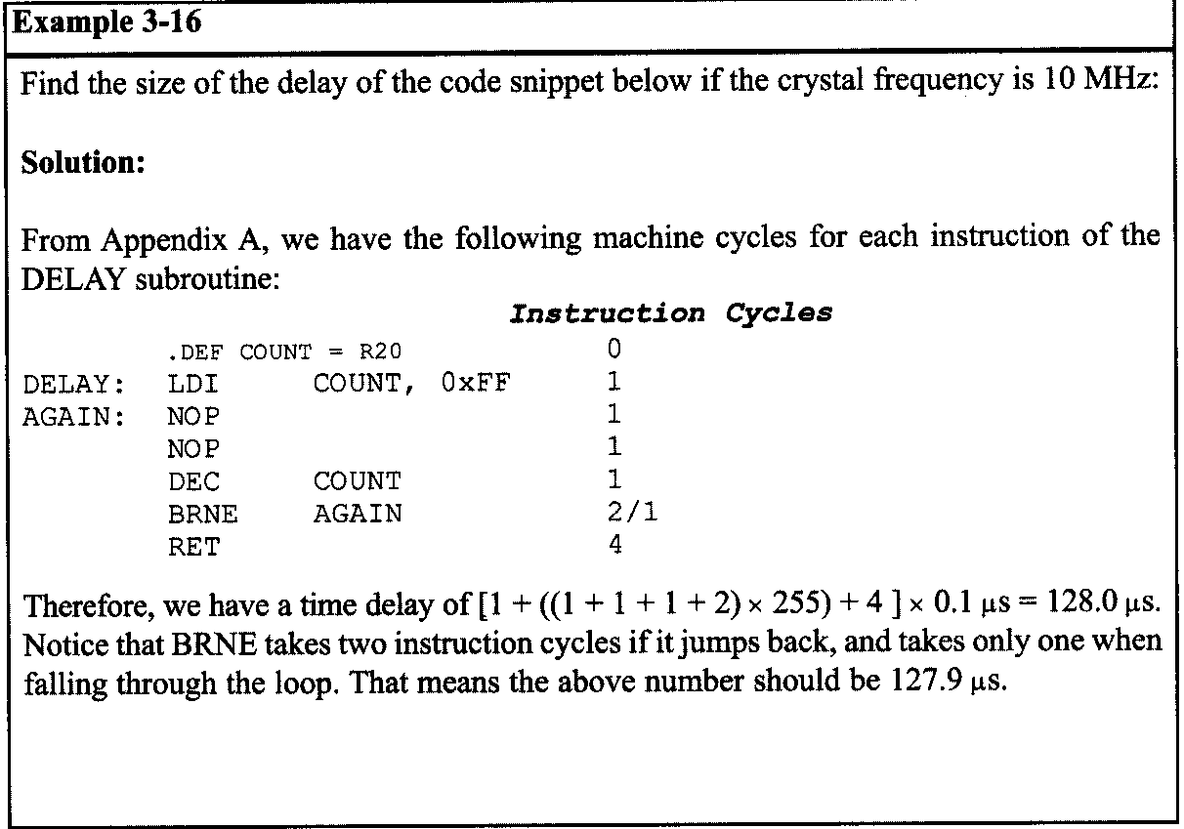
BRANCH, CALL, AND TIME DELAY LOOP 3.3: AVR TIME DELAY AND INSTRUCTION PIPELINE

Slide 51
BRANCH, CALL, AND TIME DELAY LOOP 3.3: AVR TIME DELAY AND INSTRUCTION PIPELINE
Delay calculation for AVR
As seen in the last section, a delay subroutine consists of two parts:
setting a counter, and
a loop.
Most of the time delay is performed by the body of the loop, as shown in Examples 3-17 and 3-18.

Slide 52
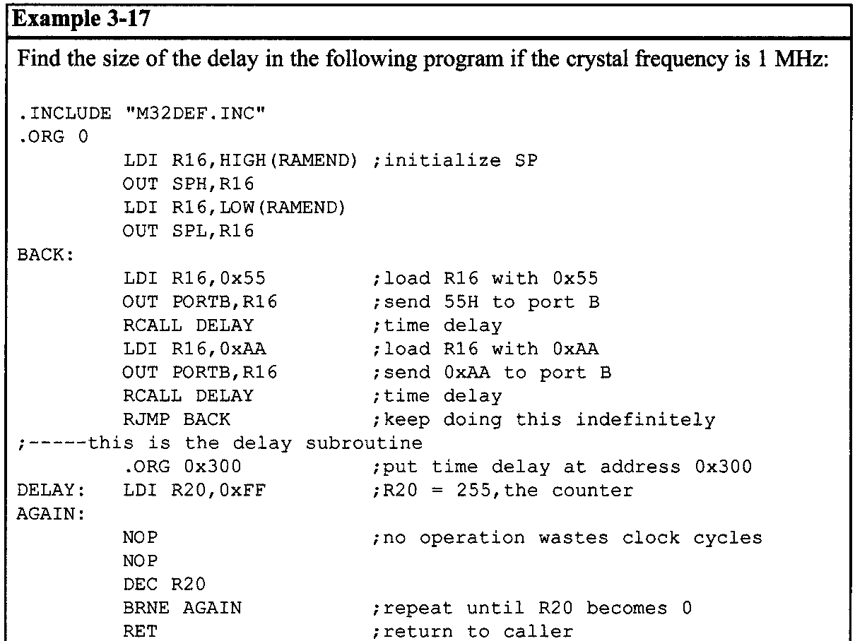
BRANCH, CALL, AND TIME DELAY LOOP 3.3: AVR TIME DELAY AND INSTRUCTION PIPELINE

Slide 53
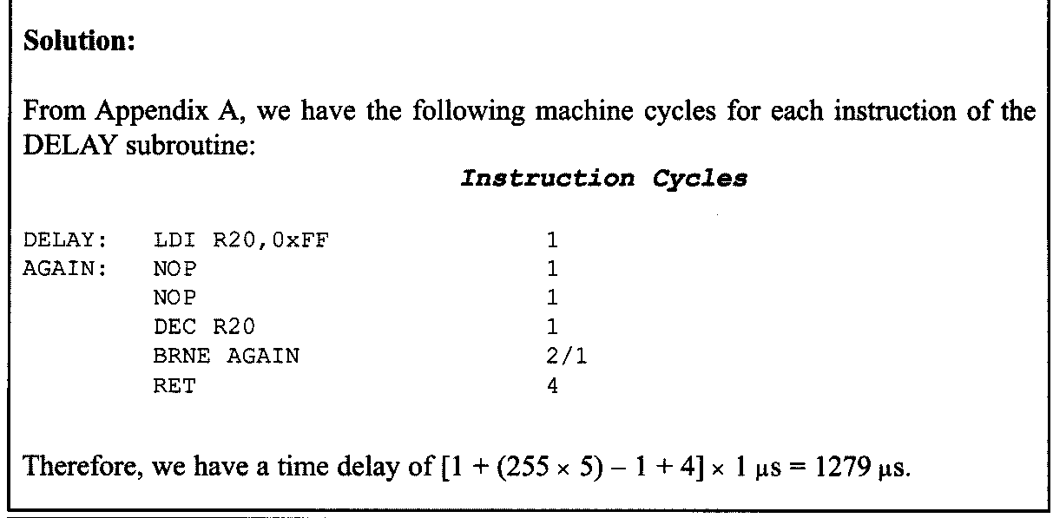
BRANCH, CALL, AND TIME DELAY LOOP 3.3: AVR TIME DELAY AND INSTRUCTION PIPELINE

Slide 54
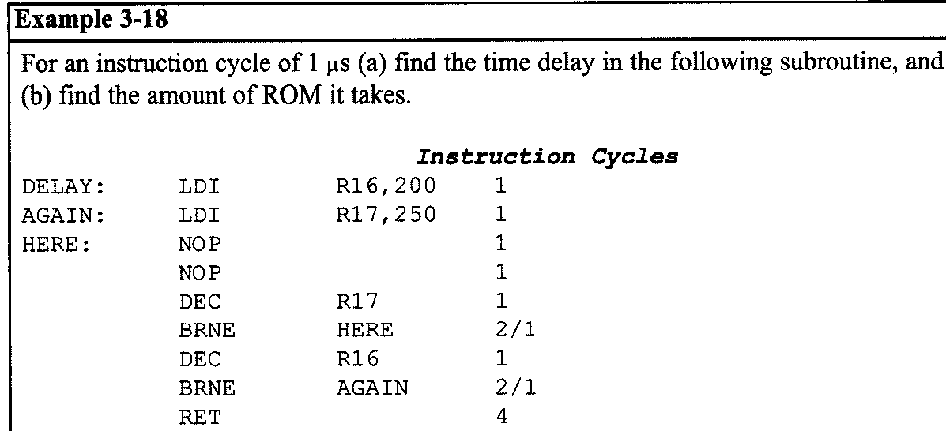
BRANCH, CALL, AND TIME DELAY LOOP 3.3: AVR TIME DELAY AND INSTRUCTION PIPELINE
Loop inside a loop delay
Another way to get a large delay is to use a loop inside a loop, which is also called a nested loop.
(a) For the HERE loop, we have [(5 x 250) - 11 x 1 μs = 1249 μs. The AGAIN loop repeats the HERE loop 200 times; therefore, we have 200 x 1249 ps = 249,800 ps, if we do not include the overhead.

Slide 55
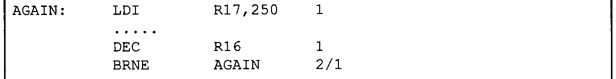
BRANCH, CALL, AND TIME DELAY LOOP 3.3: AVR TIME DELAY AND INSTRUCTION PIPELINE
However, the following instructions of the outer loop add to the delay:
The above instructions at the beginning and end of the AGAIN loop add
[(4 x 200) – 11 x 1 μs = 799 μs
to the time delay. As a result we have 249,800 + 799 = 250,599 μs for the total time delay associated with the above DELAY subroutine. Notice that this calculation is an approximation because we have ignored the "LDI R16,020" instruction and the last instruction, RET, in the subroutine.
(b) there are 9 instructions in the above DELAY program and all the instructions are 2 byte instructions. That means that the loop delay takes 22 bytes of ROM code space.

Slide 56
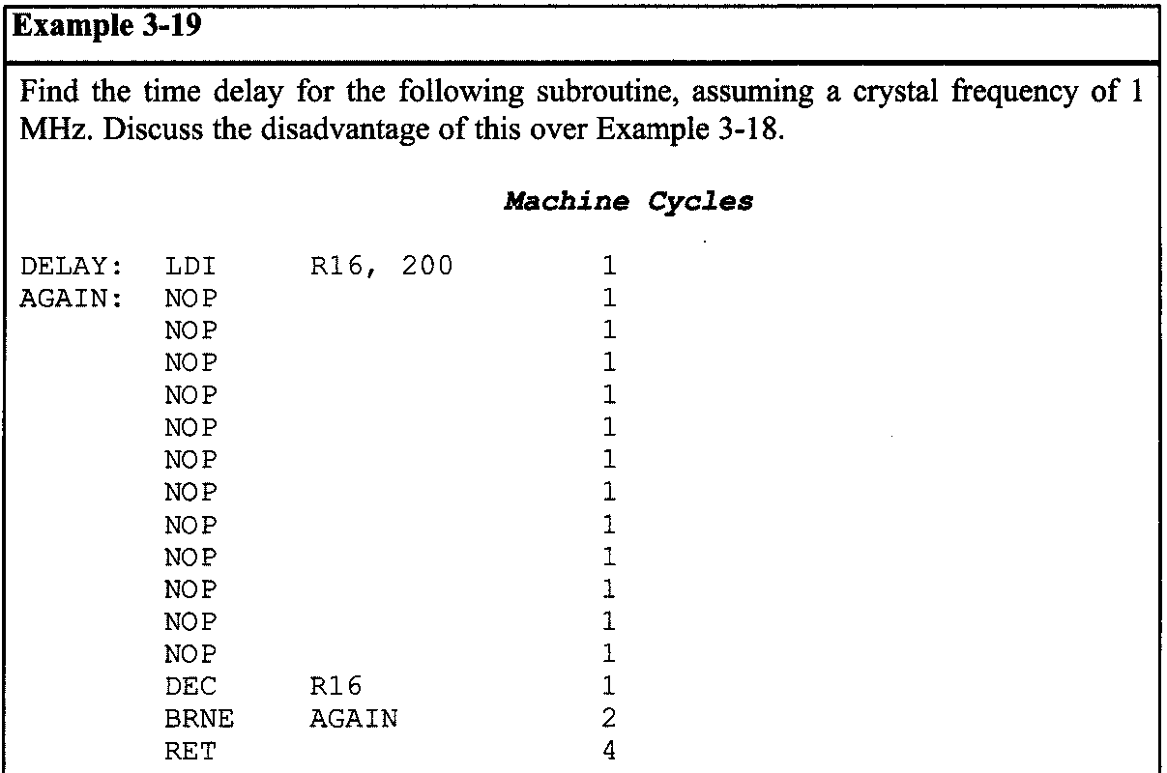
BRANCH, CALL, AND TIME DELAY LOOP 3.3: AVR TIME DELAY AND INSTRUCTION PIPELINE

Slide 57
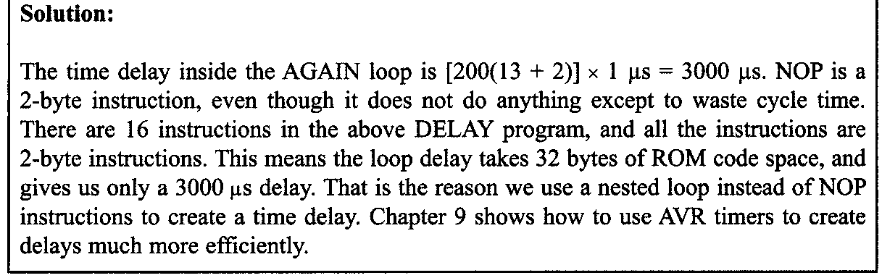
BRANCH, CALL, AND TIME DELAY LOOP 3.3: AVR TIME DELAY AND INSTRUCTION PIPELINE

